Slide 1


SuperStore – Uma frescura do C***lho
Business Intelligence - Project Proposal
Gabriel Cardoso, number: m20201027
João Lucas, number: m20200758
João Chaves, number: m20200627
Luís Almeida, number: m20200666

Slide 2
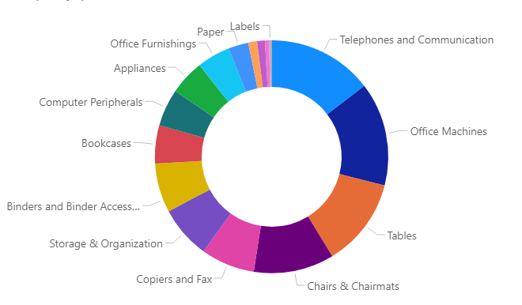
SuperStore – Areas of Business
Business Intelligence - Project Proposal
Is a multi-million dollar retailer with operations all over the globe and
Is a recognized player, dedicated to quality in every area of business.

Slide 3
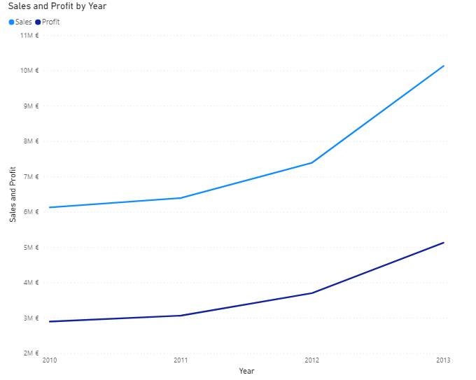
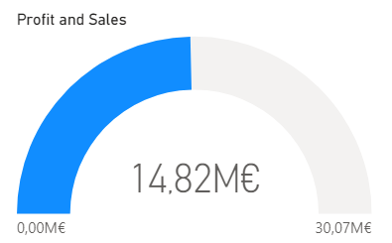
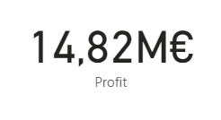
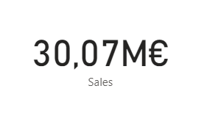
SuperStore – Sales and Profit
Business Intelligence - Project Proposal
Growth:
Total:

Slide 4
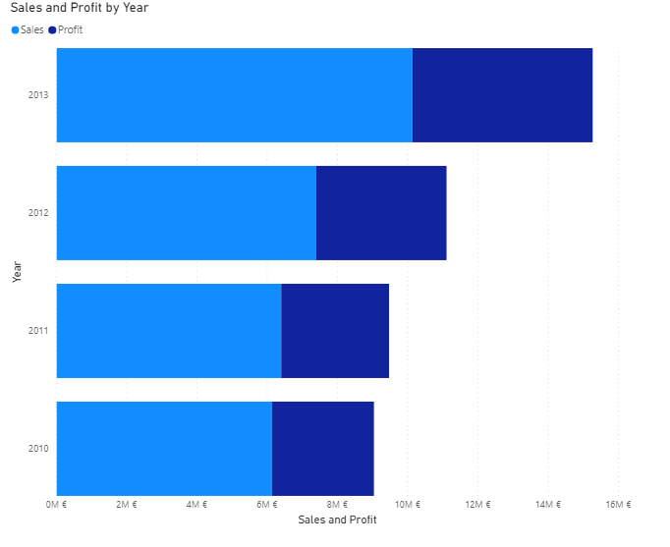
SuperStore – Sales and Profit
Business Intelligence - Project Proposal
Growth:
Total:

Slide 5
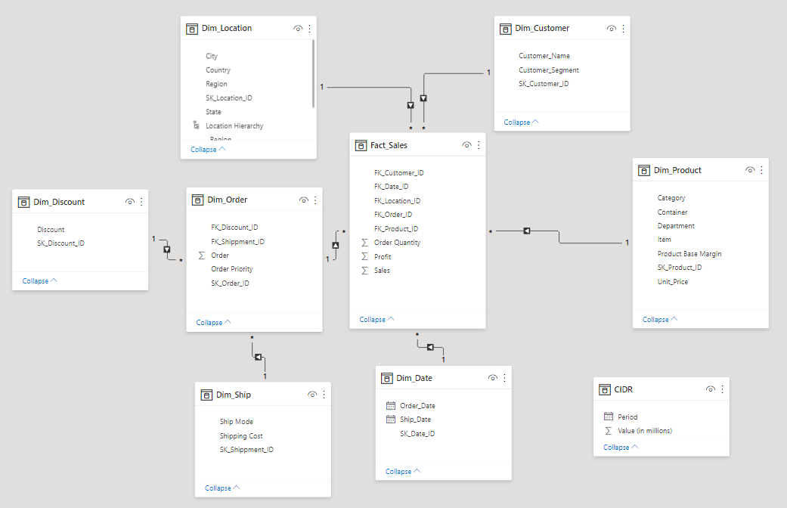
SuperStore – How Our Data Relates
Business Intelligence - Project Proposal

Slide 6

SuperStore – Data Explanation (Hierarchy/Nº de registos, etc)
Business Intelligence - Project Proposal

Slide 7
SuperStore – Our Objective
Business Intelligence - Project Proposal

Slide 8
SuperStore – USA Presence, Sales and Profit
Business Intelligence - Project Proposal

Slide 9
SuperStore – USA Opportunities
Business Intelligence - Project Proposal

